Slide 2
Terraform-ACI integration
DEVNET-2340
Devarshi Shah, TME – INSBU

Slide 3
Objectives of this session
Get an understanding of Terraform capabilities
Understand how ACI can be managed with Infrastructure-as-Code paradigms
Use Terraform plans to manage ACI application network configuration

Slide 4
What is Terraform?

Slide 5
Terraform is an Infrastructure Resources Manager
Compose and combine infrastructure resources to build and maintain a desired state
Plan and execution are distinct actions
Manages all resources through APIs
Resources and data can be re-used within modules
Terraform use core and plugins components for basic functions and extensibility

Slide 6
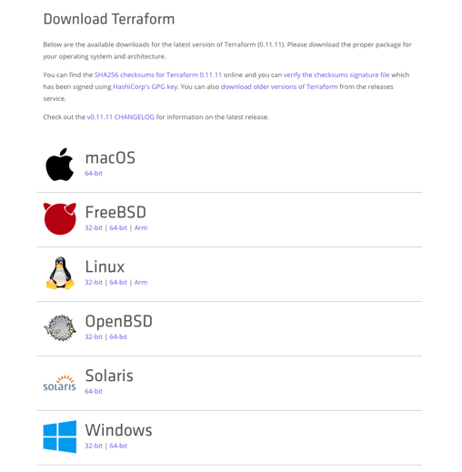
How to install it?
Go to www.terraform.io/download.html
Pick you platform
Unzip
Move binary somewhere in your PATH (e.g: /usr/local/bin)
Run terraform commands

Slide 7
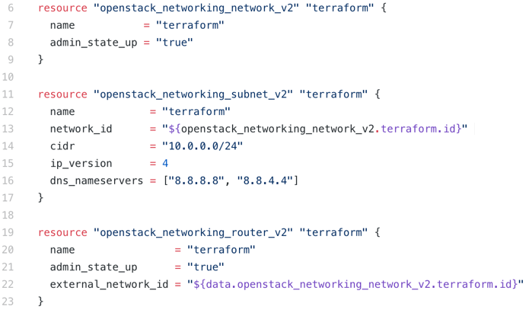
Terraform defines a high level syntax
Resources are declared in TF file
Syntax is HCL – HashiCorp Configuration Language
Human understandable

Slide 8
Terraform Providers
Providers abstract the API layer of resources providers
New resources are available for Terraform to provision and manage
AAA configuration is required as part of the provider definition in the TF file
ACI supports user and X509 certificate based authentication

Slide 9
Core Components provide Native Functions
Config: Target configuration, the desired state (.tf file)
State: The current configuration, captured in the state file (.tfstate file)
Diff: The differences between the current and the desired stated, that must be applied to the infrastructure to reconcile state with configuration.
Plan: Dry run to visually determine changes, allowing the user to review the execution plan
Apply: Resolves diff by performing appropriate CRUD operations on managed resources. It leverages relevant plugins and resource providers

Slide 10


Arguments are used to compose Resources
Type of resource
Name of the resource
Project folder
main.tf
variables.tf
terraform.tfvars

Slide 11
Arguments are used to compose Resources
Project folder
main.tf
variables.tf
terraform.tfvars
terraform.tfstate
terraform.tfstate.backup

Slide 12
How to use variables?
Declare variables and set default values
variable "aci_private_key" {
default = "/home/nvermand/fabric1_admin.key"
}
variable "aci_cert_name" {
default = "admin_cert"
}
variable "provider_profile_dn" {
default = "uni/vmmp-VMware"
}
variable "bd_subnet" {}
variable "gateway" {}
variable "vmm_domain_dn" {}
variables.tf
terraform.tfvars

Slide 13
How to use variables?
variables.tf
terraform.tfvars
Specific values for tf file, overriding default values
vsphere_compute_cluster = "pod-03"
folder = "ACI/demos"
aci_vm1_name="aci-tf-test1"
aci_vm2_name="aci-tf-test2"
aci_vm1_address = "1.1.1.10"
aci_vm2_address = "1.1.1.11"
bd_subnet = "1.1.1.1/24"
gateway = "1.1.1.1"
vmm_domain_dn = "uni/vmmp-VMware/dom-ACI-nv-POD03-VDS01"

Slide 14
Data Sources vs Resources
Resources
Data sources
Managed by Terraform RW Can be used for interpolation terraform apply and destroy modifies resources Displayed by terraform show and terraform state list | Managed by Provider RO Can be used for interpolation terraform apply and destroy don’t alter data sources lifecycle Displayed by terraform show and terraform state list
resource "aci_tenant" "terraform_ten" {
name = "terraform_ten"
}
data "vsphere_datacenter" "dc" {
name = "${var.vsphere_datacenter}"
}

Slide 15
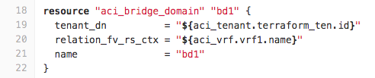
Interpolation is used to combine Resources
Reference to another resource
(aci_vrf.vrf1)
Interpolation indicates dependency
Used to build Direct Acyclic Graph (DAG) of dependencies
Determines the order of Terraform tasks
References attributes from other resources

Slide 16
Computing Resources
Resources attributes are computed as a result of running terraform tasks
Requires response from provider API
Run terraform plan to display execution plan and terraform apply to deploy resources
Attributes can be displayed after resource creation

Slide 17
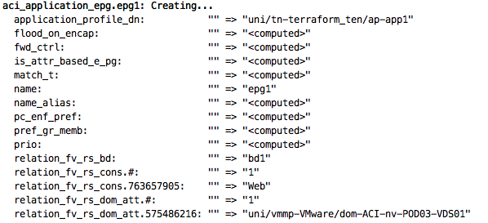
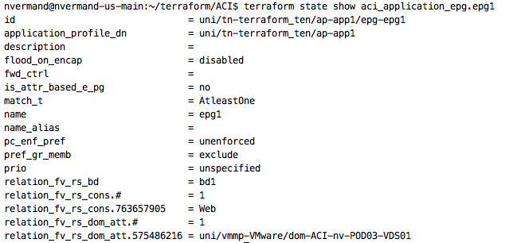
At runtime: terraform apply
After resources are provisioned

Slide 18
Infrastructure Resources Lifecycle
Remove individual resources from the infrastructure

Slide 19
Terraform manages dependencies with DAG
DAG – Direct Acyclic Graph is a directional tree without loop
Walking through multiple graphs is handled in parallel
vSphere VM
Tenant
ANP
VRF
EPG
BD
Subnet

Slide 20
Main command options
Terraform plan
Terraform apply
Terraform show
Terraform console

Slide 21
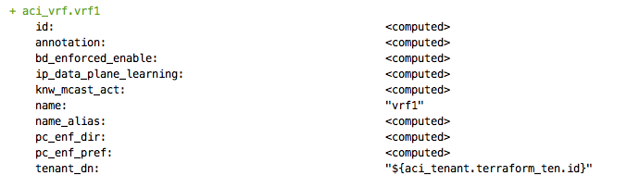
Terraform plan

Slide 22
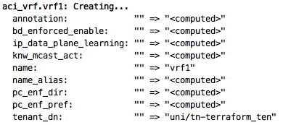
Terraform apply

Slide 23
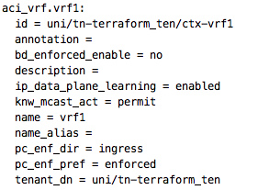
Terraform show

Slide 24
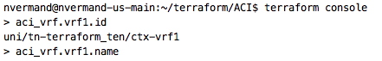
Terraform console
REPL console (Read-eval-print-loop)
Can leverage sdtin as input for inline usage

Slide 25
Anatomy of an ACI Resource in Terraform

Slide 26

Infrastructure as Code with ACI
ACI has a modeled representation of everything APIC knows
ACI object model is a distributed MIT (Management Information Tree) structure, fully accessible through REST API
Every node is a managed object (MO) with class, attributes and a distinguished name (Dn)
Root
Policy Universe
Fabric
Nodes
Hypervisors
Tenants
Applications
Virtual Network
VLANs
API
Tenant
VRF
BD
10.10.0.1/24
EPG
EPG
VLAN 1001
VLAN 1002

Slide 27
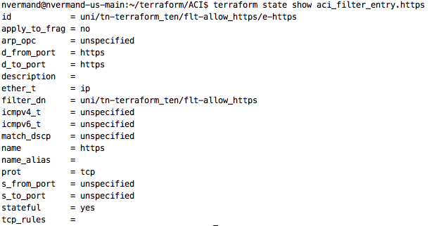
Terraform and ACI Resource Mapping
Terraform identifies ACI objects with their Dn
Terraform resource id is the absolute path of ACI object in the DMIT

Slide 28


ACI Provider Resources
 | Available | Future | Resource | Data Source
aci_tenant
aci_vrf
aci_bridge_domain
aci_subnet
aci_application_profile
aci_application_epg
aci_contract
aci_contract_subject
aci_filter
aci_filter_entry
aci_vmm_domain
aci_l3_outside
aci_external_network_instance_profile
aci_rest

Slide 29
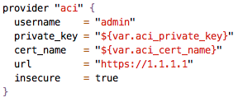
Connecting to ACI
You can use user/password or certificate base authentication
Certificates based authentication is recommended though
path to user private key
Name of cert object in ACI
APIC address

Slide 30
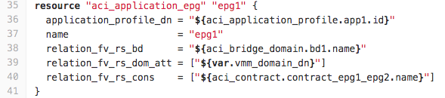
Manage Relation Source Objects
ACI leverages objects to build relations to other nodes in different part of the tree
These objects are represented as arguments under the target Terraform resource
Example with EPG that can have relation to VMM domain (fvRsDomAtt), Bridge-Domain (fvBD) and Contract consumer/provider (vzBrCP)
“uni/vmmp-VMware/dom-VDS01”
“bd1”
“Web”

Slide 31
How to install the ACI provider
Prerequisites
Go latest version
Terraform v0.11.7 onwards
Clone from github: https://github.com/ciscoecosystem/terraform-provider-aci.git
Checkout relation_test branch and build the provider binary file
$ cd terraform-provider-aci
$ git checkout relation_test
Switched to branch 'relation_test'
Your branch is up-to-date with 'origin/relation_test’.
$ make build
==> Checking that code complies with gofmt requirements...
go install

Slide 32
How to install the ACI provider
Go to you $GOBIN or $GOPATH/bin path and copy the provider binary to Terraform 3rd party plugins directory
Create your terraform working directory and build you configuration (main.tf, terraform.tfvars and variables.tf)
Initialize your configuration, which will download required providers and also reference the 3rd party plugins directory
$ cp $GOBIN/terraform-provier-aci ~/.terraform/plugins/linux_amd64
$ terraform init
...
Initializing provider plugins... ...
Terraform has been successfully initialized!
...

Slide 33
What we’re going to do
Create a Tenant in ACI
Create VRF, BD, and attach BD to VRF
Add subnet under BD
Create an 2-Tier Application Profile with EPGs and contracts
Attach EPGs to BD
Attach VMM Domain to EPG
Deploy CentOS VMs and attach them to corresponding EPGs
Test connectivity

Slide 34
After your first Terraform plan, you’ll probably want to reuse some of your work…

Slide 35
Terraform Modules are like Black Boxes
Modules create reusable components
Modules are Terraform configuration files within a folder (nothing more), but variables are not usable in main TF file outside of the module stanza
Modules only take inputs, return outputs and contain resources. From the outside, they look like functions

Slide 36
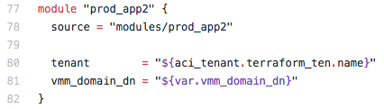
Add Module to TF file
Contextual module name
Path to module folder
Module variables may be overwritten

Slide 37
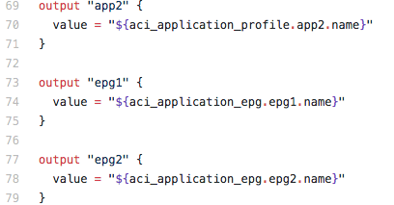
Create Module Outputs
Modules outputs are variables that can be used for interpolation
modules/prod_app2/main.tf
Main project TF file

Slide 38
Next steps for our Demo
Create a module to deploy a standardized application network profile
Change main project TF file to include the module
Use module outputs to derive new port-group
Deploy new application from module
Move VMs to the new network
Note: “git checkout master” for this part of the demo

Slide 39
ACI-Puppet Integration

Slide 40
Resources
https://github.com/ciscoecosystem/terraform-provider-aci
https://github.com/ciscoecosystem/aci-go-client
https://forge.puppet.com/cisco/cisco_aci
https://github.com/cisco/ciscoacipuppet#install-puppet-module

Slide 41
Q&A

